Slide 1

Segmentation - Models

Slide 2
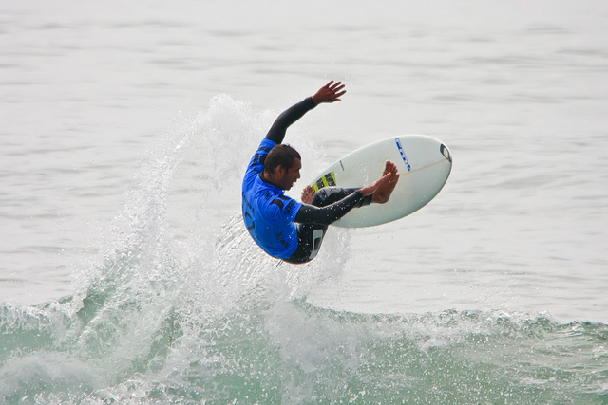
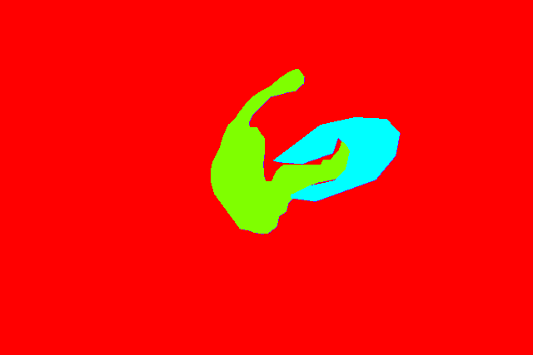
water
surfboard
human
Water(0)
Surfboard(1)
Human(2)

Slide 3
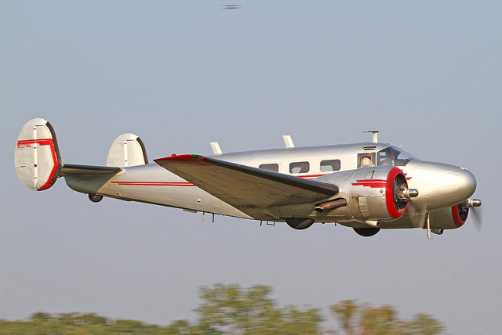
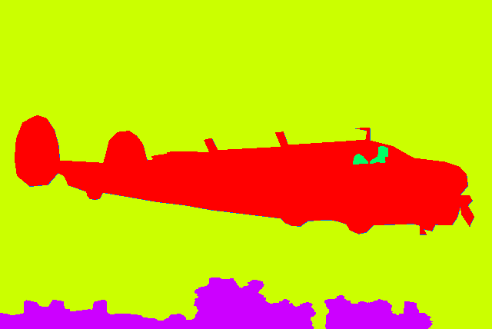
Sky
Human
airplane
trees

Slide 4
Encoder Network
High level features
Classifier
224, 224
112, 112
56 , 56
28, 28
14, 14
7, 7
Input Image
(512, 512, 3)
Conv1 (kernel_size: 7x7, stride: 2),
max pool( kernel_size: 3 x 3, stride: 2)
Resblock 1
Resblock 2
Resblock 3
Resblock 4
1000 softmax
1, 1
Average pool (7 x 7)
3
2048
64
256
512
1024
2048

Slide 5
224, 224
224, 224
Encoder
Decoder
High level features
3
N_class

Slide 6
Input Image
(512, 512, 3)
Output (512, 512)
512, 512
3
512, 512
sigmoid
1
518, 518
BN
Pad (3, 3)
3
Output channels
512, 512
Conv,
Kernel (3, 3) pad=same
1
2 similar conv layers
Output feature map size
256, 256
Conv, BN , Relu
Kernel (3, 3) Stride (2, 2)
64
512, 512
Conv , BN , Relu
Kernel (3, 3)
16
2x
258, 258
Pad (1, 1)
64
512, 512
Upsample
(2, 2)
32
128, 128
Max pool
Kernel (3, 3), Stride (2, 2)
64
256, 256
Conv , BN , Relu
Kernel (3, 3)
32
2x
128, 128
Stage-1
ResBlock
64
Concat
256, 256
128
128, 128
Stage-2
BN, Relu
64
256, 256
Upsample
(2, 2)
64
130, 130
Stage-2
Pad
64
Skip connections
128, 128
Conv, BN , Relu
Kernel (3, 3)
64
2x
64, 64
Stage-2
ResBlock
128
128, 128
Concat
192
128, 128
Upsample
(2, 2)
128
64, 64
Stage-3
BN, Relu
128
64, 64
Conv, BN , Relu
Kernel (3, 3)
128
2x
66, 66
Stage-3
Pad
128
64, 64
Concat
384
32, 32
Stage-3
ResBlock
256
64 , 64
Upsample
(2, 2)
256
32, 32
Stage-4
BN, Relu
256
32, 32
Conv, BN , Relu
Kernel (3, 3)
256
2x
34, 34
Stage-4
Pad
256
32, 32
Concat
768
16, 16
Stage-4
ResBlock
512
16, 16
BN
Relu
512
32, 32
Upsample
(2, 2)
512

Slide 7
LinkNet
Input Image
(512, 512, 3)
Output (512, 512, Num_classes)
512, 512
3
512, 512
Conv, Activation
Kernel (3, 3) pad=same
Num_classes
518, 518
BN
Pad (3, 3)
3
Output channels
Conv, BN , Relu
Kernel (1, 1)
512, 512
16
Output feature map size
256, 256
Conv, BN , Relu
Kernel (3, 3) Stride (2, 2)
64
Upsample- conv2d (kernel 3x3) or Conv2DTranspose
BN Relu
512, 512
16
258, 258
Pad (1, 1)
64
256, 256
Conv BN Relu
Kernel (1, 1)
16
128, 128
Max pool
Kernel (3, 3), Stride (2, 2)
64
+
256, 256
Conv, BN , Relu
Kernel (1, 1)
64
128, 128
Stage-1
ResBlock
64
256, 256
Upsample- conv2d (kernel 3x3) or Conv2DTranspose
BN Relu
16
Stage-2
BN, Relu
128, 128
Conv BN Relu
Kernel (1, 1)
16
Add the Features
128, 128
64
+
130, 130
Stage-2
Pad
64
128, 128
Conv, BN , Relu
Kernel (1, 1)
64
Stage-2
ResBlock
128, 128
Upsample- conv2d (kernel 3x3) or Conv2DTranspose
BN Relu
32
64, 64
128
Skip connections
Conv BN Relu
Kernel (1, 1)
64, 64
32
64, 64
Stage-3
BN, Relu
128
+
64, 64
Conv, BN , Relu
Kernel (1, 1)
128
66, 66
Stage-3
Pad
128
Upsample- conv2d (kernel 3x3) or Conv2DTranspose
BN Relu
64, 64
64
32, 32
Stage-3
ResBlock
256
Conv BN Relu
Kernel (1, 1)
32, 32
64
32, 32
Stage-4
BN, Relu
256
+
32, 32
Conv, BN , Relu
Kernel (1, 1)
256
34, 34
Stage-4
Pad
256
Upsample- conv2d (kernel 3x3) or Conv2DTranspose
BN Relu
32, 32
128
16, 16
Stage-4
ResBlock
512
16, 16
BN
Relu
512
Conv BN Relu
Kernel (1, 1)
16, 16
128

Slide 8
PSPNet
480, 480
Input Image
(480, 480, 3)
3
Output
(480, 480, Num_classes)
486, 486
BN
Pad (3, 3)
3
Output channels
sigmoid/softmax
Output feature map size
Conv, BN , Relu
Kernel (3, 3) Stride (2, 2)
480, 480
Resize/ConvBlock
Num_Classes
240, 240
64
242, 242
Pad (1, 1)
64
60, 60
Conv(1, 1) , Relu, BN
Num_Classes
120, 120
Max pool
Kernel (3, 3), Stride (2, 2)
64
Conv Blocks to increase feature layers
60, 60
Conv(1, 1) , Relu, BN
512
Pooling operations
120, 120
Stage-1
ResBlock
64
Pyramid Pooling Module
120, 120
Stage-2
BN, Relu
64
1, 1
1, 1
60, 60
Pooling
(60, 60)
Conv2d
(1, 1), same, Relu
Resize
122, 122
Stage-2
Pad
64
128
512
512
60, 60
Stage-2
ResBlock
128
2, 2
2, 2
60, 60
Pooling
(30, 30)
Conv2d
(1, 1), same, Relu
Resize
128
512
512
60, 60
Concat
512*4+128=2176
60, 60
Stage-3
BN, Relu
128
3,3
3, 3
60, 60
Pooling
(20, 20)
Conv2d
(1, 1), same, Relu
Resize
128
512
512
6, 6
6, 6
60, 60
Pooling
(10, 10)
Conv2d
(1, 1), same, Relu
Resize
128
512
512

Slide 9
FPN
512, 512
Input Image
(512, 512, 3)
3
518, 518
BN
Pad (3, 3)
3
Output channels
Output (512, 512, Num_classes)
Output feature map size
256, 256
Conv, BN , Relu
Kernel (3, 3) Stride (2, 2)
64
Activation
Num_classes
512, 512
258, 258
Pad (1, 1)
64
2 similar conv layers
Resize (to image size)
TopDown layer
Segmentation layer
512, 512
Num_classes
128, 128
Max pool
Kernel (3, 3), Stride (2, 2)
64
128, 128
2x
128,, 128
Conv (3, 3)
Num_classes
128, 128
Stage-1
ResBlock
64
128, 128
Add
Conv(3x3), Padding=same
Conv, BN , Relu
Kernel (3, 3)
512
256
128
128,, 128
128, 128
Stage-2
BN, Relu
64
128, 128
128, 128
Concate
Conv (1 x 1)
BN, Relu
Resize
128,, 128
512
130, 130
Stage-2
Pad
64
256
256
64, 64
Stage-2
ResBlock
128
64, 64
64, 64
2x
128, 128
Add
Conv(3x3), Padding=same
Resize(2, 2)
64, 64
Stage-3
BN, Relu
128
256
128
128
64, 64
64, 64
Stage-3
Pad
Conv (1 x 1)
BN, Relu
Resize
66, 66
128
256
256
32, 32
Stage-3
ResBlock
256
32, 32
32, 32
2x
128, 128
Add
Conv(3x3), Padding=same
Resize(4x4)
32, 32
Stage-4
BN, Relu
256
256
128
128
Stage-4
Pad
32, 32
32, 32
34, 34
256
Conv (1 x 1)
BN, Relu
Resize
16, 16
Stage-4
ResBlock
512
256
256
16, 16
16, 16
2x
128, 128
16, 16
BN
Relu
512
Conv (1 x 1)
BN, Relu
Conv(3x3), Padding=same
Resize(8, 8)
256
128
128

Slide 10
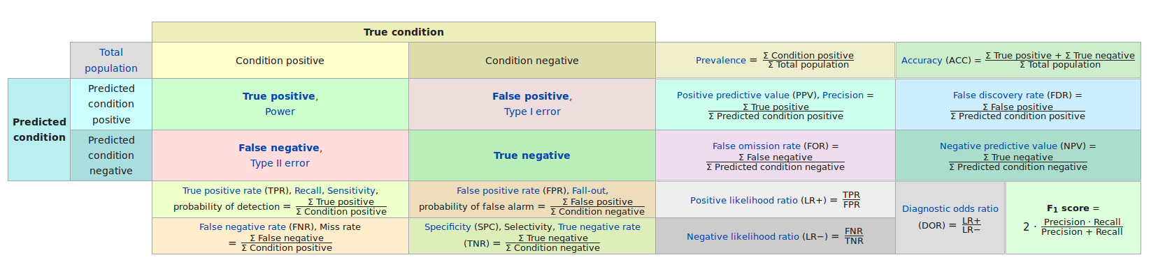

Slide 11
Metric IOU SCORE
Intersection of Actual and Predicted
A(Predicted)
B(Actual)
Ground truth
False negatives
True Positives
Overlap
Area of Overlap
Predicted
False Positives
=
=
=
IoU
Area of union

Slide 12
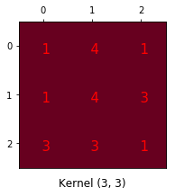
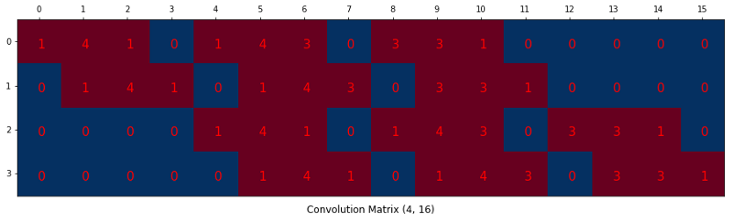

Slide 13
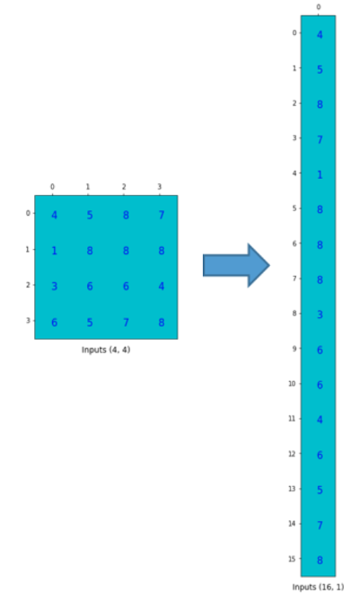
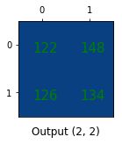
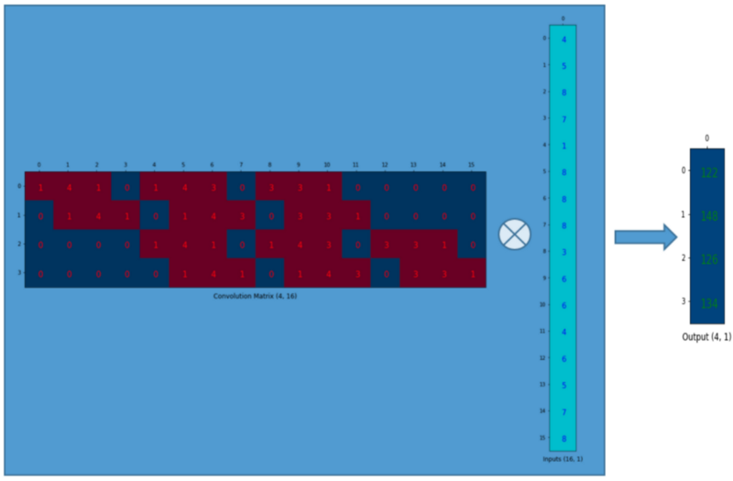
Reshaping input matrix
Matrix multiplication
Output matrix reshaped

Slide 14
